Slide 1
Crafting & Compelling Website Analysis, Audit and Recommendations Project

Slide 2
AMAZON
Amazon is an American multinationaltechnology company, engaged in e-commerce. Amazon was founded on July 5, 1994, by Jeff Bezos in Bellevue, Washington. The company originally started as an online marketplace for books but gradually expanded its offerings to include a wide range of product categories and online shopping.

Slide 3
PRODUCTS
RETAIL GOODS (Retail, by definition, involves the sale of goods and services to consumers for their own use. Amazon fits this description perfectly, as it sells products in small quantities directly to end-users).
CONSUMER ELECTRONICS (Consumer electronics are a wide range of electronic devices that are used for general purposes, such as entertainment or in the home. Amazon sells consumer electronics, and also produces some of its own consumer electronics products).
AMAZON STUDIOS (Amazon Studios is a film and television production and distribution company that offers services and products).

Slide 4
SERVICES
DELIVERY AND LOGISTICS (Amazon Logistics is Amazon's delivery and shipping service that uses a variety of delivery partners to get packages to customers).
AMAZON WEB SERVIES (Amazon Web Services (AWS) is a cloud computing platform that offers a variety of services).
AMAZON PRIME (Amazon Prime is a subscription membership to Amazon that offers customers premium services for a yearly or monthly fee. Amazon Prime provides discounts on shipping, a free membership to Prime Video, Twitch Prime, Amazon Drive and thirty minutes early access to Lightning Deals for a yearly subscription fee).
ENTERTAINMENT (Amazon offers a variety of home entertainment products, including music systems, amplifiers, and projection screens).

Slide 5
AMAZON DRIVE (Amazon Drive is a secure cloud storage service that lets you store, access, and manage your files, photos, and videos. You can use Amazon Drive).

Slide 6
WEBSITE PLATFORM IDENTIFICATION
AWS FOR CLOUD SERVIES
JAVASCRIPT FOR FRONTEND
JAVA,C++ AND PERL FOR BACKEND
DYNAMODB, RDS/AURORA, REDSHIFT FOR DATABASE

Slide 7
RESPONSIVE DESIGN TESTING
RESPONSIVE DESIGN TEST REPORT:
WEBSITE - https://www.amazon.com/
TOOL - (PAGESPEED INSIGHTS WEB DEVELOPER).
HOME PAGE ( Render-Blocking Resources, Defer Offscreen Images, Minimize main-thread work ).
HELP PAGE ( Page Speed, First Consenful Paint, Reduce unused JavaScript ).
TODAY DEALS PAGE ( Cumulative Layout Shift (CLS), Largest Contentful Paint (LCP), Time to First Byte (TTFB) ).

Slide 8
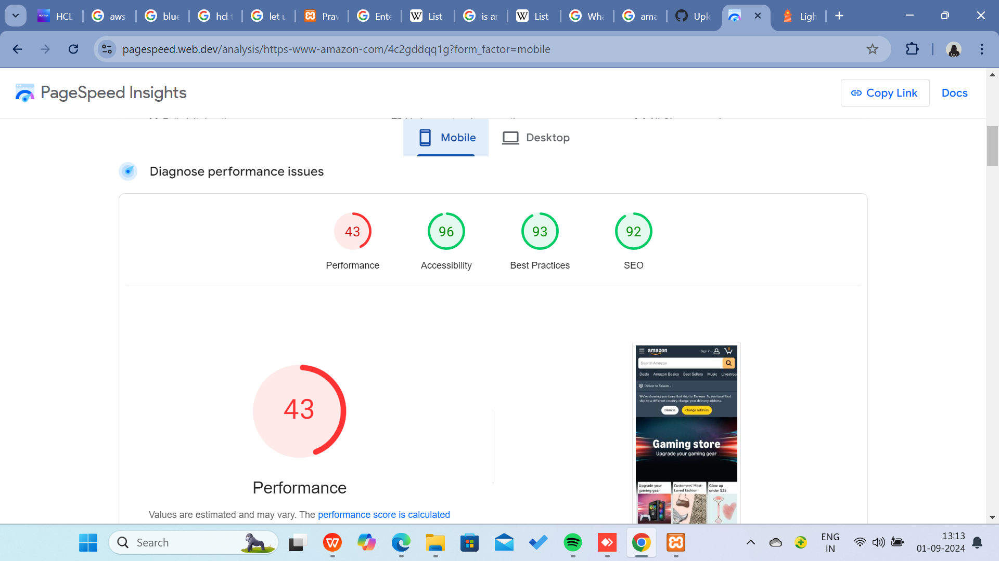
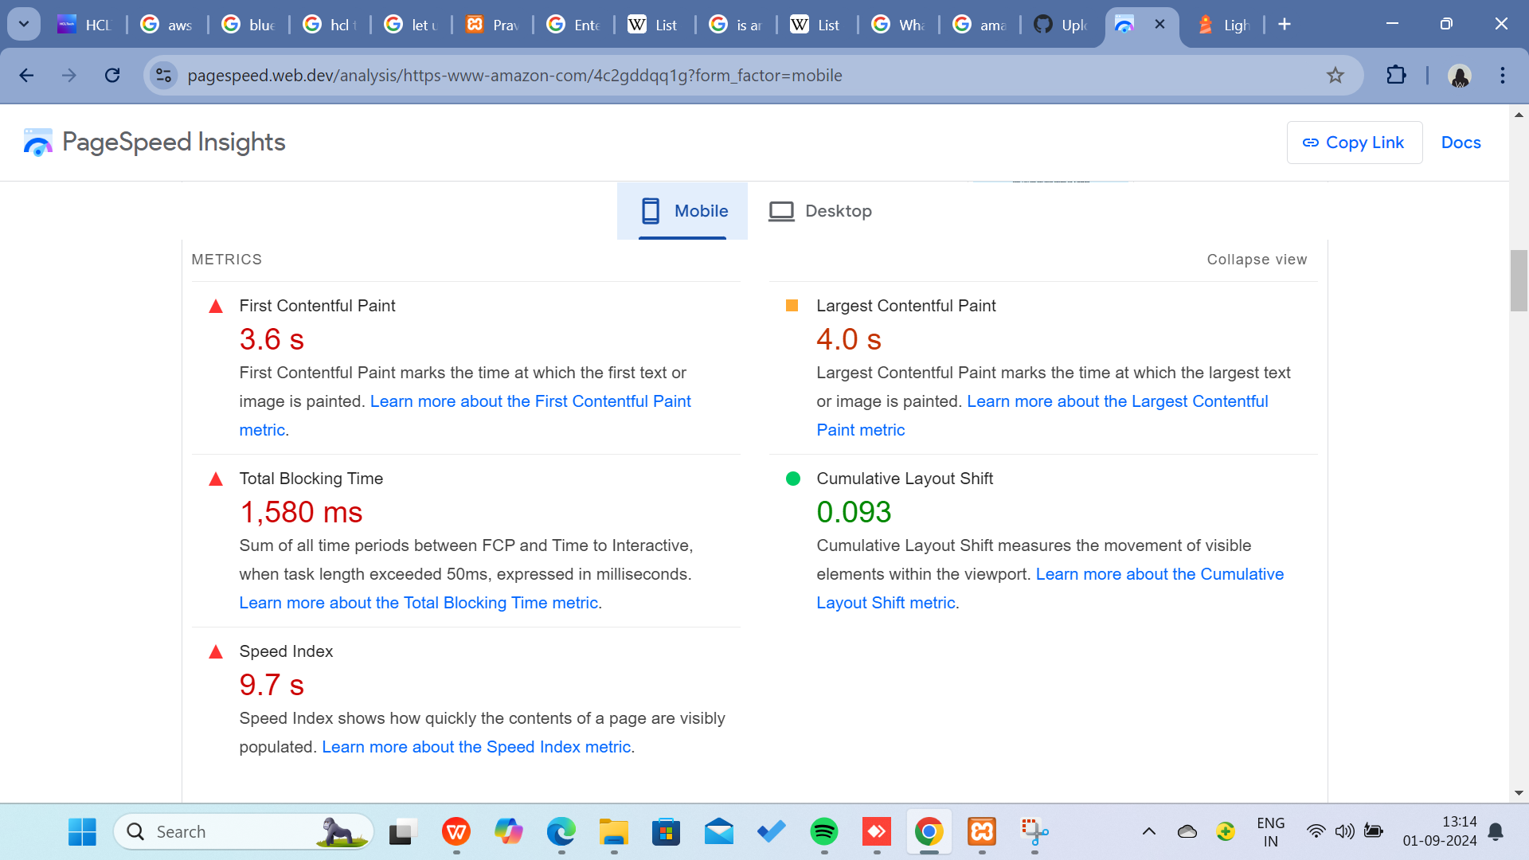
DIGITAL SERVICES PAGE ( Interaction to Next Paint (INP), Interaction to Next Paint (INP), Serve images in next-gen formats, Avoid enormous network payloads ).
SELL PAGE ( Speed Index, Properly size images, Minimize main-thread work ).
I Added Screenshot of the Page Report Down Below:

Slide 9
WEBSITE MISTAKES IDENTIFICATION
TO IMPROVE THE MISTAKES:
Reduce the buffering and Increase the loading Page Speed.
Modifying your webservers configuration file or use a plugin like 10Web Booster hosting to ensure your site is configured with optimized caching settings.
Cluttered layouts: Too many elements, inconsistent spacing, and overwhelming visuals and white spaces can confuse visitors.
Poor image optimization, slow servers can decrease users.
Optimise the image size low with good quality.

Slide 10
BEST PRACTICES LIST
BEST PRACTICE LIST FOR THE WEBSITE:
SIMPLICITY
VISUAL HIERARCHY
NAVIGABILITY
RESPONSIVITY
ACCESSIBILITY
CONSISTENCY
FAST LOAD TIMES
ENGAGING CONTENT
USER-CENTRIC DESIGN
SEO-FRIENDLY

Slide 11
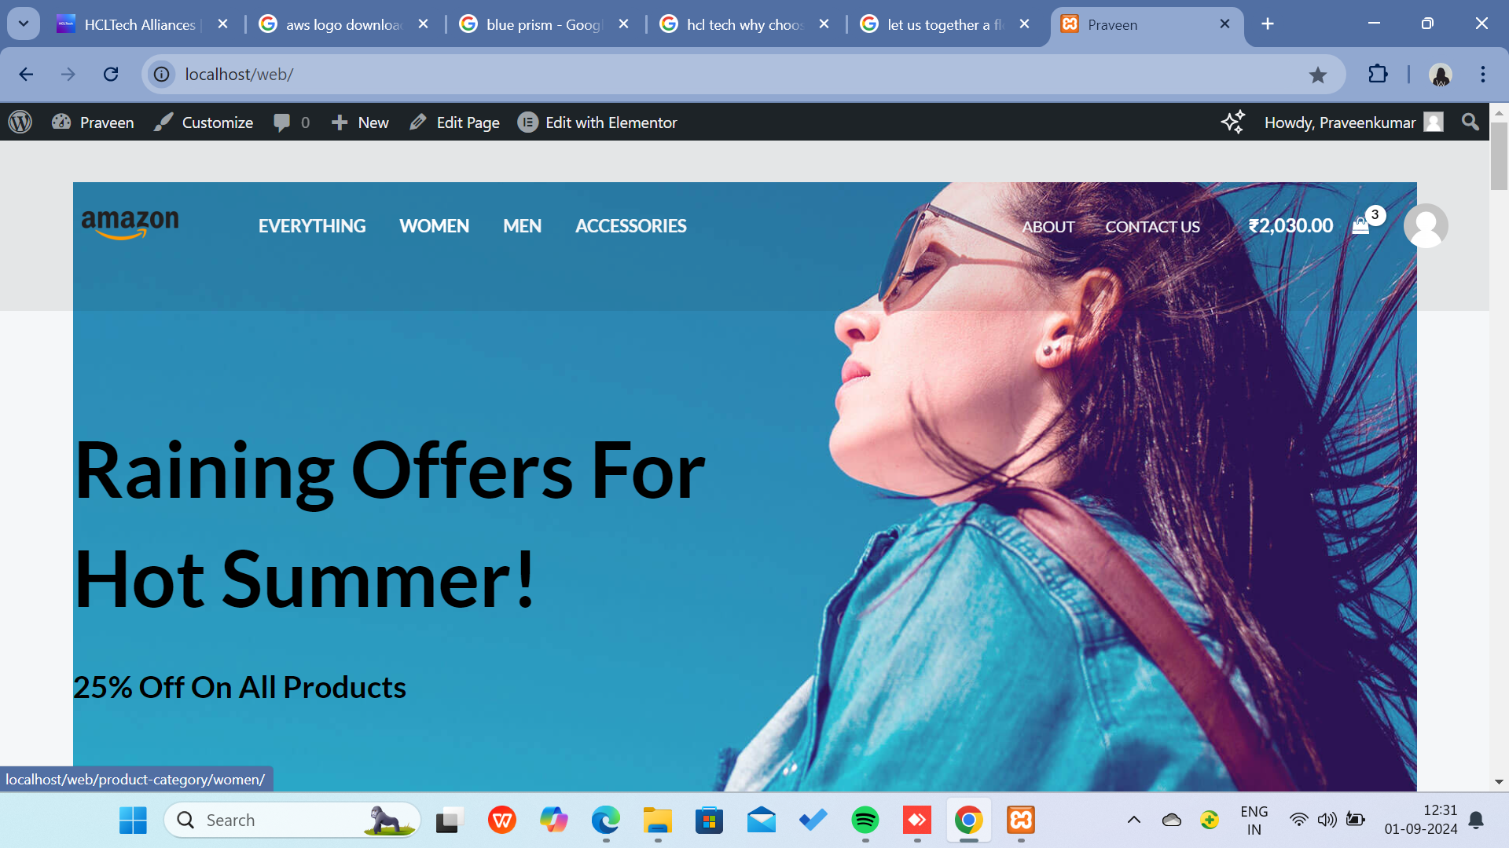
WEBSITE DESIGN
WORDPRESS SITE LINK FOR WEBSITE: http://localhost/web/
I Added Screenshot Of The Website Down Below:

